Slide 1



Motivation, self esteem and Confidence

Slide 2


Aims and objectives
Understand what is motivation, self- esteem and confidence
Identify what you do well and what you could do better
Learn top tips for being more confident
Explore what motivates you and gain self-esteem

Slide 3
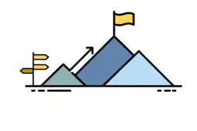
What is motivation?
Motivation:
Having a reason to do something, that encourages you to do it

Slide 4

What motivates you?
Write down 3 things that motivate you

Slide 5
What motivates you to do well at a task?
Write down 3 ideas

Slide 6

What is Self-Esteem?
Self-esteem is the opinion we have of ourselves. When we have healthy self-esteem, we tend to feel positive about ourselves and about life in general. It makes us able to deal with life’s ups and downs better.

Slide 7
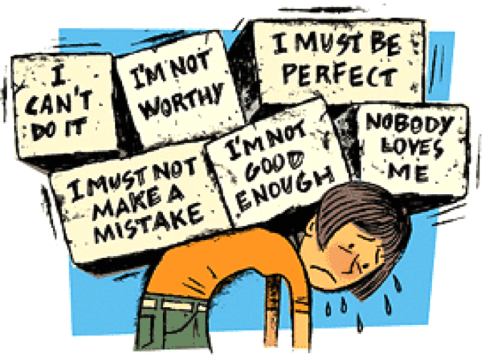
What is low Self-Esteem?
When our self-esteem is low, we tend to see ourselves and our life in a more negative and critical light. We also feel less able to take on the challenges life throws at us.

Slide 8

Low Self-Esteem and the Workplace
How can low self-esteem affect you in the workplace?

Slide 9
Low Self-Esteem and the Workplace
Difficulty with new tasks and challenges
Un motivated
Unproductive
Poor appearance
Absent from work
Difficulty making friends
Negative attitude

Slide 10
What is high Self-Esteem?
When you feel good about yourself and think you are a person of value and you have belief in yourself to be able to go and achieve something.

Slide 11

Self Reflection
Fear and Anxiety crushes confidence and affects our self esteem.
Sometimes we can be our own worst enemy. The fear of failure or not being good enough can stop ourselves achieving as we find it hard to see our positive attributes.

Slide 12

What Makes You Feel Good?
Write down what makes you feel good when you’re struggling with things

Slide 13

What is confidence?
Confidence:
Feeling sure about your abilities, qualities or ideas.
Saying something and feeling sure it is correct.

Slide 14

How can we act confidently?

Slide 15
Top Tips
Maintain eye contact and use positive body language
Choose words carefully and choose the right time to talk
Be clear about what you want, make requests clear
Stay calm

Slide 16

Please fill out your feedback form

Slide 17
Thank you

